Slide 1
SHIRE MVP Plan
SHIRE MVP on RBC environment.

Slide 2




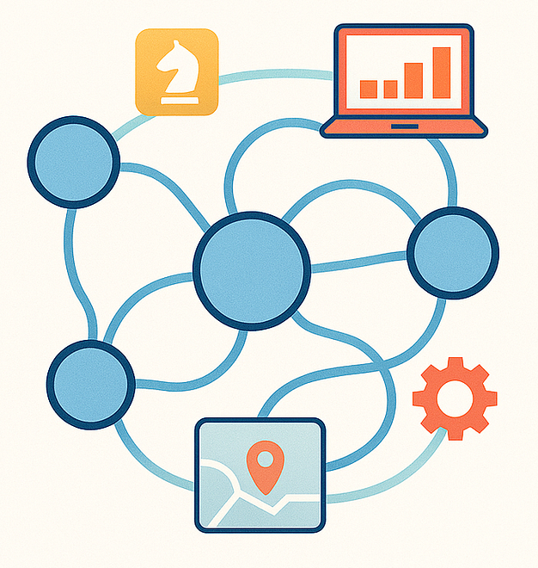
Current Procedure
Live VM with a vulnerability.
ssh
- SHIRE Agentic AI solution
Dev with knowledge of the:
VM (OS, app directory, file structure, libraries installed, and others)
Vulnerability (Vuln ID, CVE details, how to fix, previous resolution knowledge, resolution steps from internal tool)
- Vulnerability
- Live VM with vuln
- Tableau dashboard
- Developer

Slide 3


SHIRE procedure
Live VM with a vulnerability.
ssh
- SHIRE Agentic AI solution
- Vulnerability
VM (OS, app directory, file structure, libraries installed, and others)
Vulnerability (Vuln ID, CVE details, how to fix, previous resolution knowledge, resolution steps from internal tool)
- Live VM with vuln
- Tableau dashboard
- Developer

Slide 4









SHIRE Framework
memory
Redhat
Intent
classifier

Slide 5
Current Scope of MVP
Work on end-to-end resolution of most recurring-simple vulnerabilities.
Phase 1
  A chat interface for a human to interact with the agentic-framework to be able to resolve vulnerabilities.
  The framework provides all required tools to fix a vulnerability.
  Every step is taken by a human expert (SME) and the workflow is under control. (steps taken by SME are recorded for training the model.)
  Time-line = 6 weeks
  Work with an SME to resolve vuln on daily basis.

Slide 6
Features in focus
Target most recurring-simple vulnerabilities.
Jira stories for tracking and auditing.
Lang-graph memory to save state variables.
Graph DB

Slide 7
SHIRE procedure
Live VM with a vulnerability.
ssh
Missing components in
RBC env
- SHIRE Agentic AI solution
- Vulnerability
VM (OS, app directory, file structure, libraries installed, and others)
Vulnerability (Vuln ID, CVE details, how to fix, previous resolution knowledge, resolution steps from internal tool)
- Live VM with vuln
- Tableau dashboard
- Developer

Slide 8
Dependencies
Databricks
  Access to internet to fetch CVE details (Redhat API, cve.org, cisa.gov)
  Unable to install Python libraries on databricks using internal databricks library manager. (due to blocked pypi servers)
Dedicated SME. (2-4hrs support everyday).
  understanding current procedure.
  identifying reliable websites for CVEs/solutions for patching
  Gain domain expertise
  Work one-on-one on fixing simple vulnerabilities. (generate training data)
All historical vulnerability data with below columns. (to build graph db)
  [App Code, App Name, Asset Name, ENV, Platform, Exposure, First Detection Date, Fix By Date, Status, Treatment Owner, Vuln ID, Vuln Name, App Coordinator, App Custodian, CUSO, L3 Name (ITPM), L4 Name, L5 Name, SOC1/SOX/CJ]

Slide 9
Timeline
Week 1,2 – Update the SHIRE framework to utilize an internal DB to fetch pre-saved CVEs. (gain internet access on RBC databricks)
Week 3,4,5,6,7,8 – Work with an SME one-on-one to resolve vulnerabilities on RBC network.
Week 9,10 – Analyze recorded SME steps and design workflow.
Week 11, 12 – Buffer time to deliver MVP

